Slide 1
Sustainability Strategy
Spanish Olympic Committee
Manuel Parga
Marketing Director & Responsible for Sustainability

Slide 2
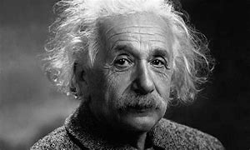
What can we do in our planet?
If you want different results…… do not do the same thing

Slide 3
Back to our Childhood
What can we do in our planet?

Slide 4
What can we do for our planet?

Slide 5
Aligned with SDGs
Social
17
Environment
Economic
#SomosDeporteSostenible

Slide 6
6+2 lines of action
Promotion of Sport and good habits among society
Energy efficiency and use of renewable sources of energy in HQ
Promotion of sustainable mobility in all of our operations
Digital Transformation in our operations to gain efficiency and reduce the consumption of energy, consumables and generate less waste
Reduce, Recycle Reuse in all of our consumables ( textile)
Gender equality in our organization and in sports organization. Empowerment of women in Sports Organizations.
Reduce hunger and poverty in Spanish society.
Educational programmes in SDGs focussing in younger generations and managers of sports organizations.
Health & Wellbeing
Energy Efficiency
Mobility
Circular Economy
Digital Transformation
Gender Equality
Social Action
Education
#SomosDeporteSostenible

Slide 7
3 spheres of action
Health & Wellbeing
Energy Efficiency
Mobility
Circular Economy
Internal Operations
Spanish Olympic Movement
Sporting Events
Digital Transformation
Gender Equality
Social Action
Education
#SomosDeporteSostenible

Slide 8
In partnership with
#SomosDeporteSostenible
PENDIENTE

Slide 9
In partnership with
Health & Wellbeing
Energy Efficiency
Mobility
Circular Economy
Digital Transformation
Gender Equality
Social Action
NGO´s
Education
#SomosDeporteSostenible

Slide 10
What we have done so far
2017
2018
2019
2020/21
Hybrid mobility
No plastic
100% Clean Energy
Supply Chain Protocol
IOC Working Group
Waste Management
1st Women Programme
2nd Women Programme
Sustainable Merchandising
1st Sport Summit
SDGs Educat. Programme
UN Global Compact
1st Sports for Climate Action
2nd Sport Summit
Environment
Memberships
EU Climate Pact Ambassadors
Educational Programmes
SDG´s SCR
Certificate
Achievements
#SomosDeporteSostenible

Slide 11
What is next?
What can we do for our planet?

Slide 12
Carbon Footprint Calculator Scopes 1+2+3
Objective: a tool for the Sport Federations and Sport Events Organising Committees to measure and evaluate their carbon footprint
Partners:
#SomosDeporteSostenible

Slide 13
Sustainable Sport Organisation Seal
Objective: Guide to apply SDGs in Sport Federations. COE Certificate & Bureau Veritas Audit
Partners:
#SomosDeporteSostenible

Slide 14
Sustainable Sport Events Seal
Objective: Guide to apply SDGs in Sport Events
COE Certificate
& Bureau Veritas Audit
Partners:
#SomosDeporteSostenible

Slide 15
Spanish Olympic Forest
Objective: Initiative to compensate carbon footprint generated by Sport in Spain
Partners:
#SomosDeporteSostenible

Slide 16
Educational Programme in Schools
Objective: Train of Trainers.
Educational programme about 17 SDGs with workshops related to sport. Scope: 7-17 years old.
Pilot in Malaga Schools to be scaled up to rest of schools Spain in 6 years
Partners:
#SomosDeporteSostenible

Slide 17
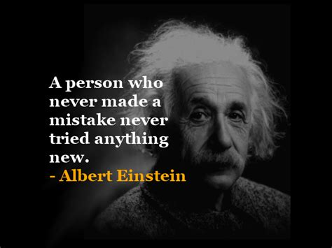

Slide 18
Building a better world through sport
Stronger together
#SomosDeporteSostenible

